Slide 1
DATA DEDUPLICATION BY END -TO-END TRAFFIC REDUNDANCY ELIMINATION
Team Members
Pragathi Thammaneni
Sridevi Mallipudi

Slide 2
DATA DEDUPLICATION:
Data deduplication is a specialized data compression technique for eliminating duplicate copies of repeating data
Often called as
Intelligent (data) compression
Single-instance (data) storage
Used to improve storage utilization and can also be applied to network data transfers to reduce the number of bytes that must be sent.

Slide 3
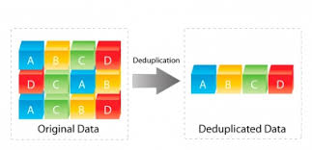
DATA DEDUPLICATION:
In this process, unique chunks of data, or byte patterns, are identified and stored during a process of analysis.
Chunks are compared to the stored copy and whenever a match occurs, the redundant chunk is replaced with a small reference that points to the stored chunk.

Slide 4
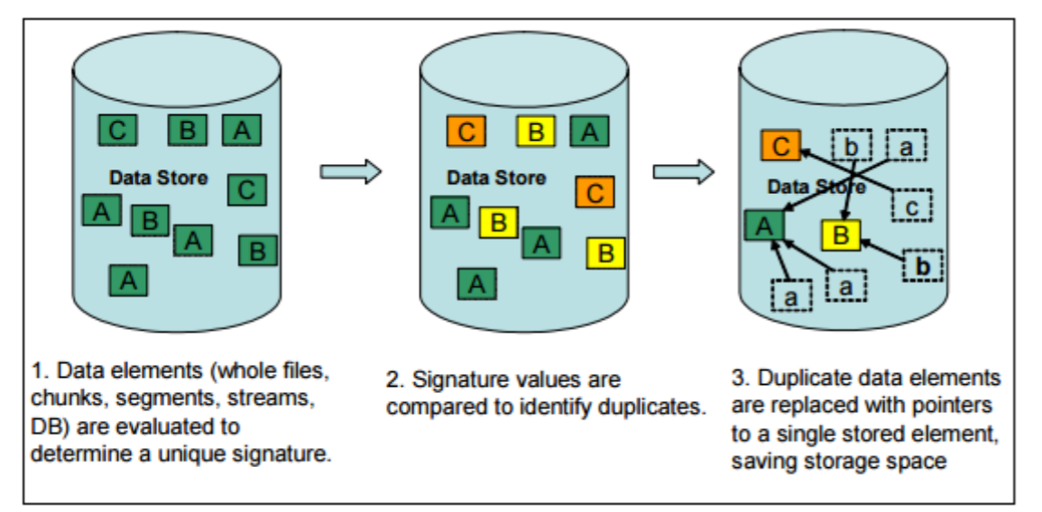
How DATA DEDUPLICATION works:
Data deduplication compares objects (usually files or blocks) and removes objects (copies) that already exist in the data set.
Process consists of four steps:
Divide the input data into blocks or “chunks.”
Calculate a hash value for each block of data.
Use these values to determine if another block of the same data has already been stored.
Replace the duplicate data with a reference to the object already in the database.

Slide 5
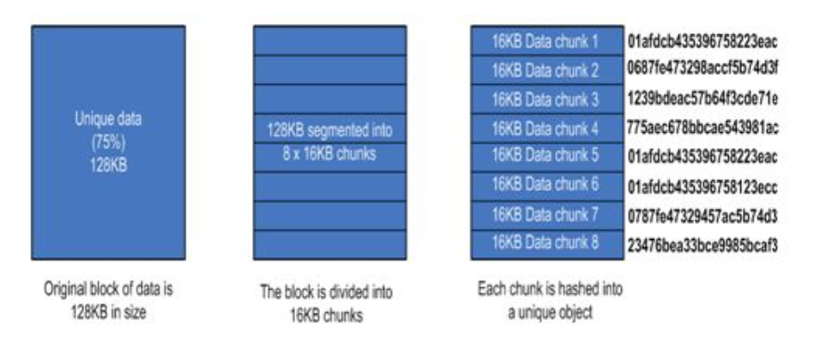
DATA DEDUPLICATION:

Slide 6
Why DATA DEDUPLICATION:
The benefits of data deduplication includes:
01
Reduced hardware costs
02
Reduced backup costs
03
Reduced costs for business continuity / disaster recovery;
04
Increased storage efficiency and
05
Increased network efficiency
06

Slide 7
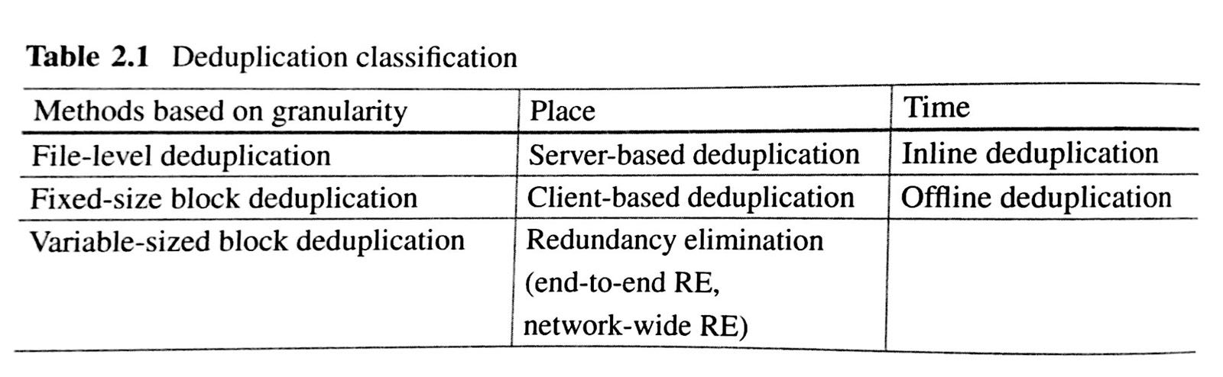
DATA DEDUPLICATION classification:
Refer Text Book :Data deduplication for data optimization for storage and network systems
Daehee Kim ,Sejun Song ,Baek-Young Choi
End-to-end RE removes redundant network traffic at two end points(e.g sender to receiver).

Slide 8
CoRE: Cooperative End-to-End Traffic Redundancy Elimination for Reducing Cloud Bandwidth Cost
Reference: IEEE paper by Lei Yu, Haiying Shen, Karan Sapra, Lin Ye, and Zhipeng Cai
http://ieeexplore.ieee.org/document/7488173/
CoRE solution has the capability of removing both short-term and long-term redundancy such that traffic redundancy can be eliminated to the highest degree.
CoRE involves two layers of cooperative TRE operations:
Prediction-Base Chunk-Match(Long-term Redundancy)
In-Chunk Max-Match(Short-term Redundancy)

Slide 9
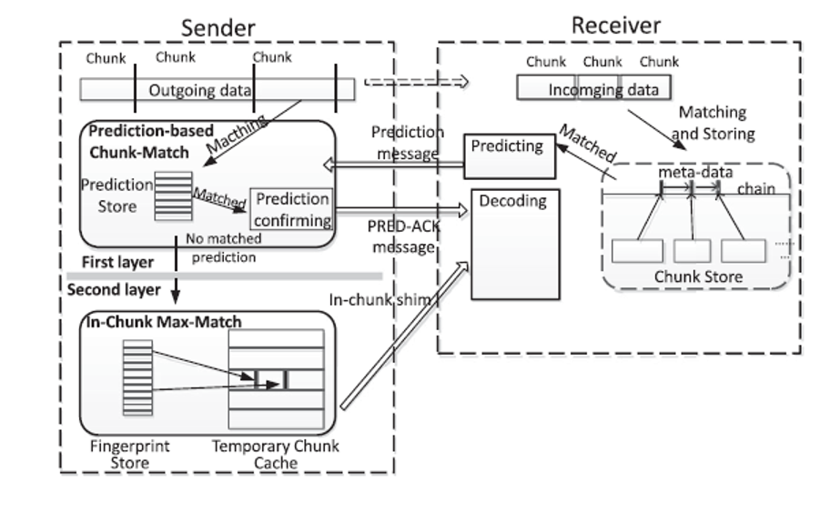
CoRE Design:
Fig. Overview of CoRE
References: http://ieeexplore.ieee.org/document/7488173/

Slide 10
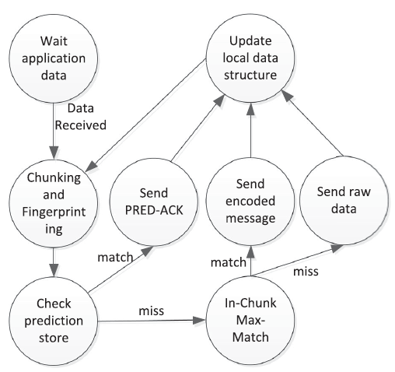
CoRE Sender:
References: http://ieeexplore.ieee.org/document/7488173/

Slide 11
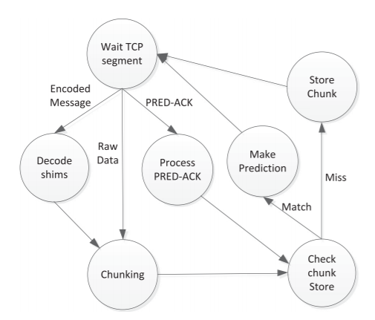
CoRE Receiver:
References: http://ieeexplore.ieee.org/document/7488173/

Slide 12

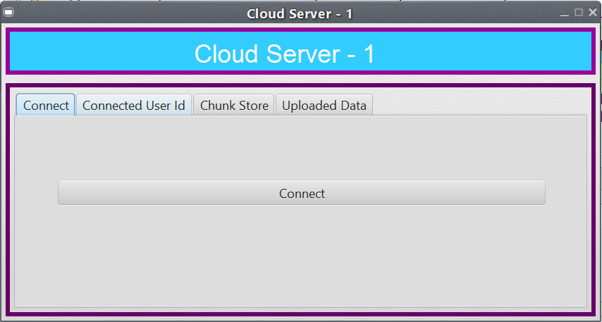
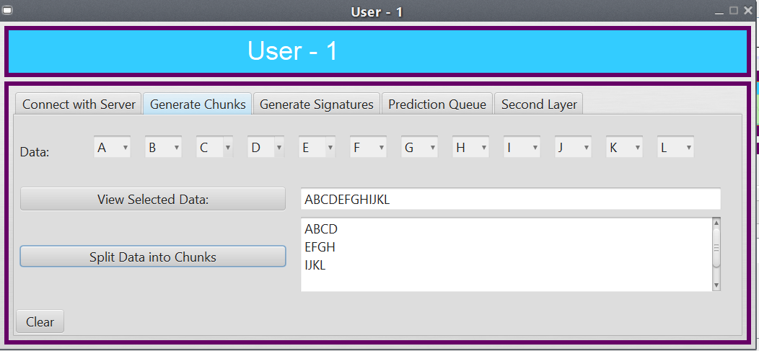
Implementation(Admin,Server,User):

Slide 13
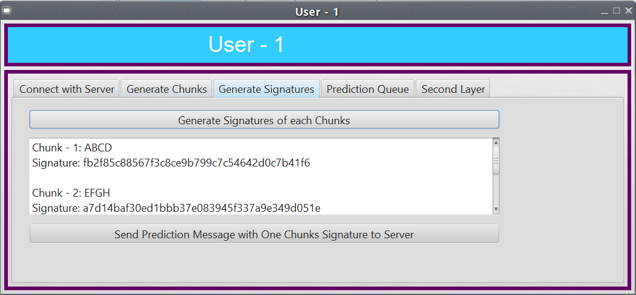
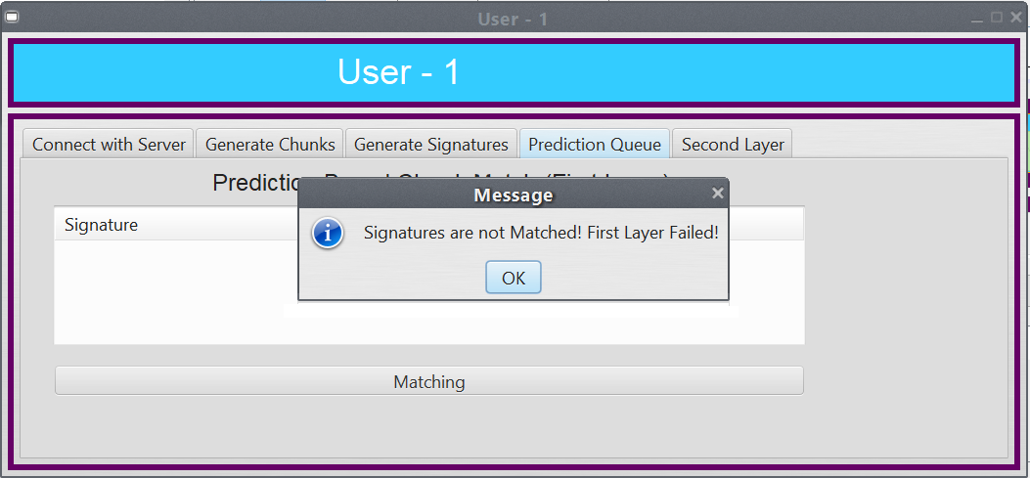
Generating Signatures & Prediction Queue:

Slide 14
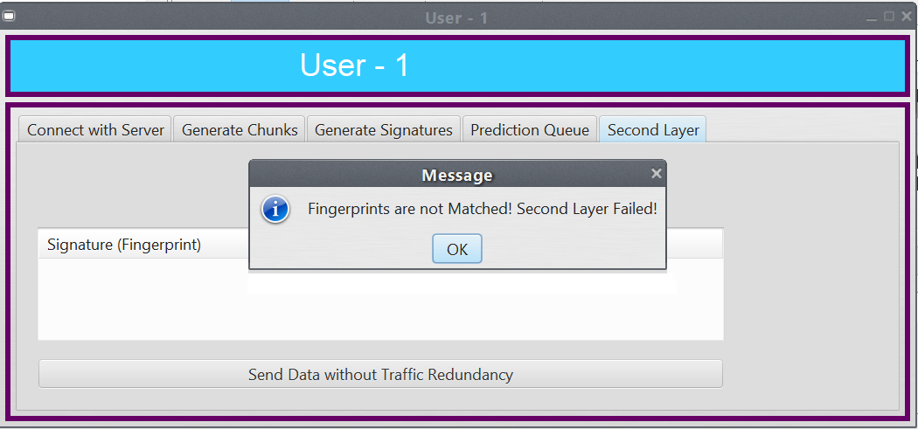
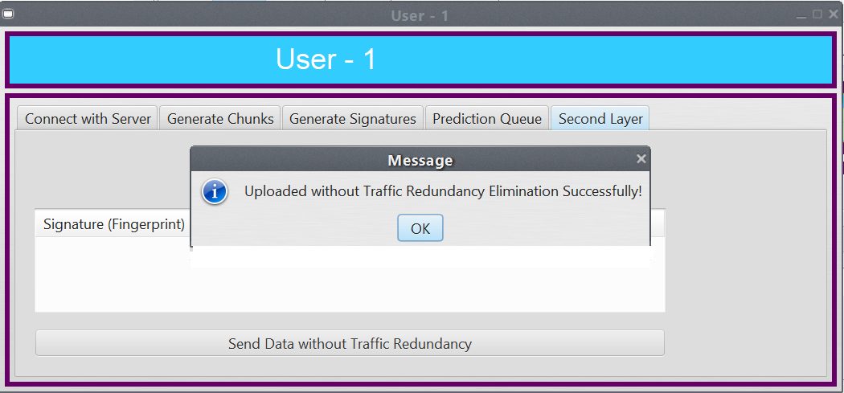
Second Layer &Data upload without TRE:

Slide 15
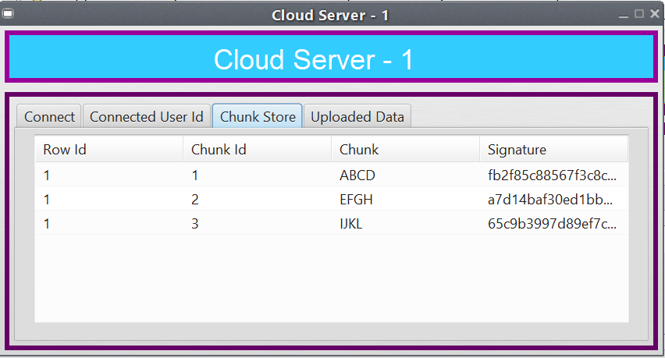
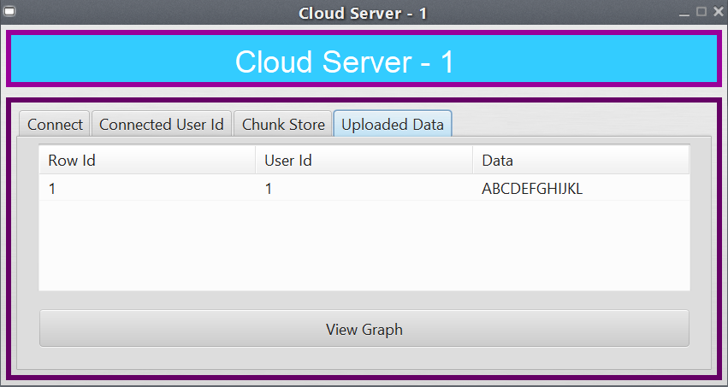
Chunk Store & Uploaded data :

Slide 16
Retransmitting the same data :

Slide 17
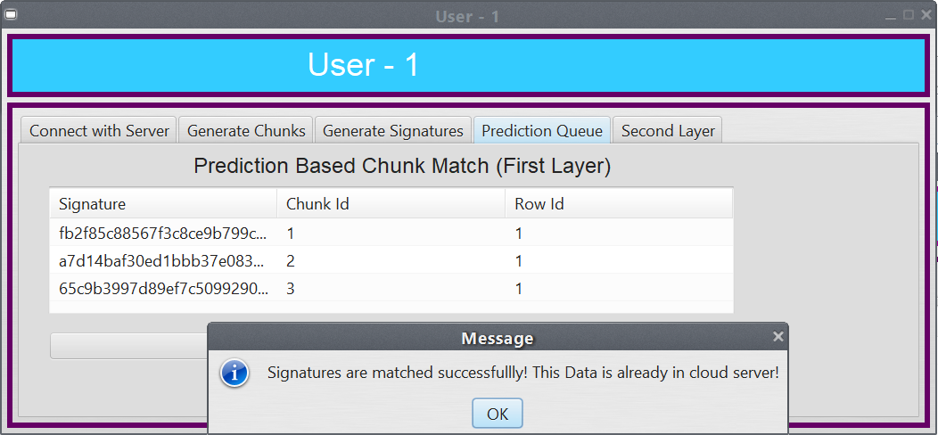
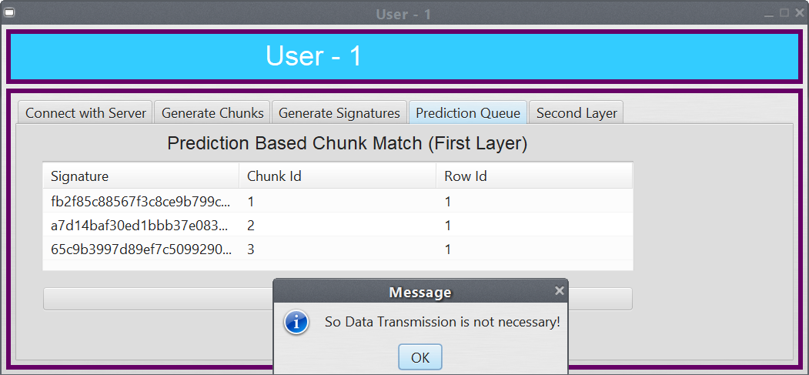
Matched case :

Slide 18
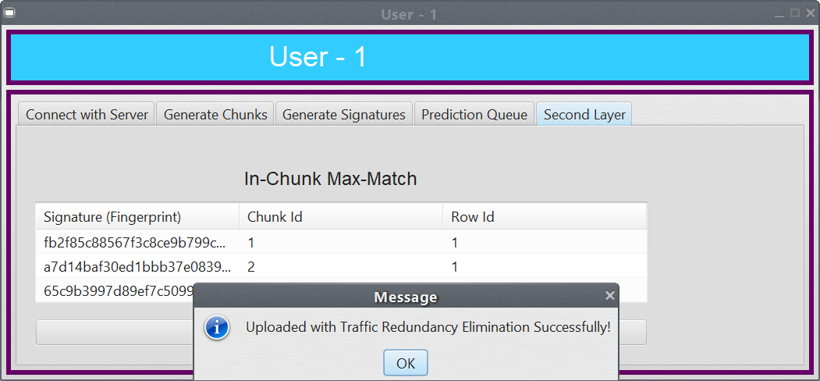
Uploaded Data with TRE:

Slide 19
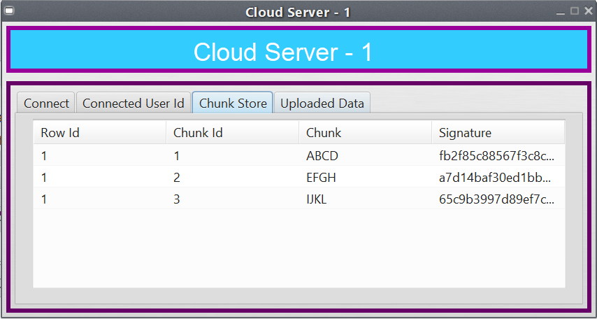
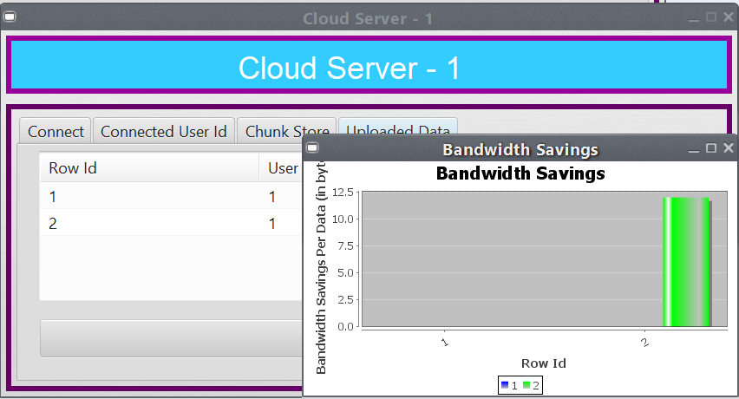
Chunk store after retransmission:

Slide 20
Thank You…!!!

